Slide 1
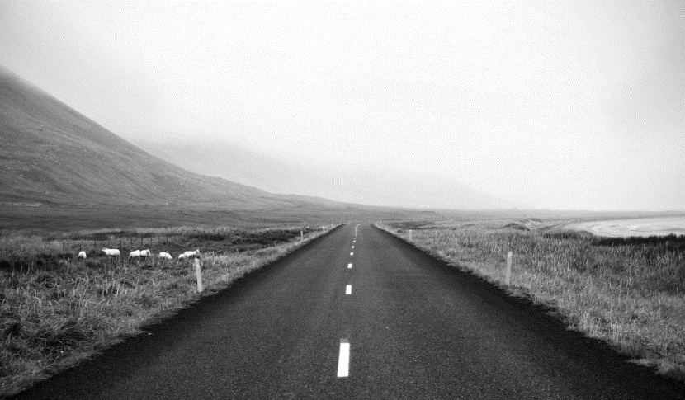
Diabetes Prediction

Slide 2
Supervised By
Dr.Ahmed Hamza
Eng.Safinaz Allam

Slide 3
Antony Ehab Shehata 2100511
Aya Ayman Esmat 2100539
Beshoy Waseem Moneir 2100577
Nouran SafaaEldein Anwar 2101362
Youstena Emad Gaber 2101760
Youssef Mamdouh Makram 2101736
Ziad Moustafa Thabet 2101788

Slide 4
More than 500 million people worldwide suffer from diabetes, posing a significant challenge to public health, Which is about 10.5% of the adult population (20-79 years) as the IDF Diabetes Atlas (2021) reports
There are people who actually don’t know the they could have diabetes, those are called Pre-Diabetic. They resembles a 5.8% (298 million) of the global adult population aged 20–79 years who have a IFG (Impaired fasting glucose) which is a type of Pre-Diabetic
Egypt has the highest number of diabetes cases in the Arab world, with approximately 10.9 million people affected.
Globally, over 90% of diabetes cases are type 2, which often develops due to factors such as obesity, poor nutrition, sedentary lifestyles, and genetic predisposition. According to estimates by the International Diabetes Federation, one in ten adults worldwide is currently living with diabetes
Introduction

Slide 5
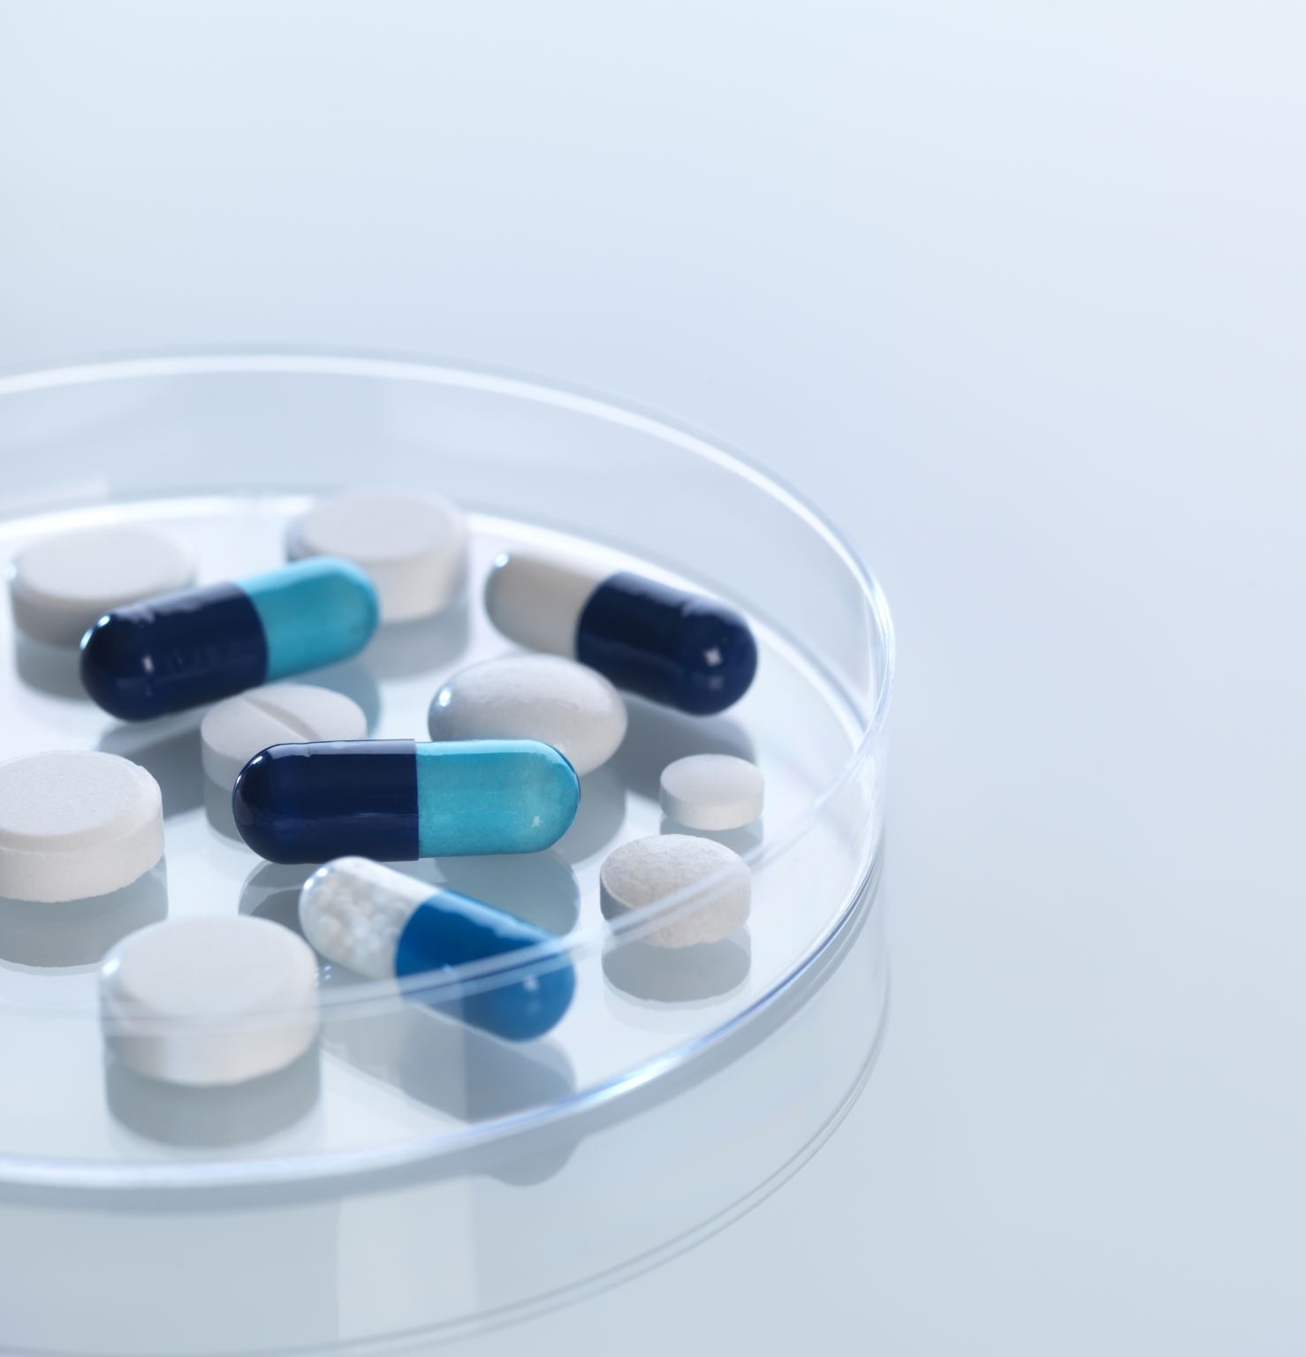
Project Goals:
early detection of diabetes from symptoms using machine learning.
Simplifying Blood Glucose reading as most of devices show only the result number only.
Help users observe their weight and what it indicate to (under normal ,normal weight , over weight ,obese)
prediction the type of diabetes using machine learning.
Help users with some food tips for type1 of diabetes and type 2

Slide 6
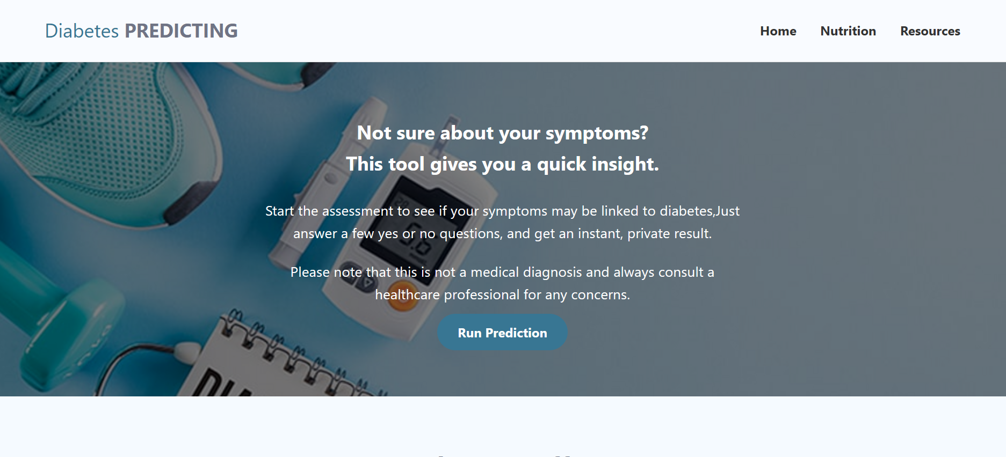
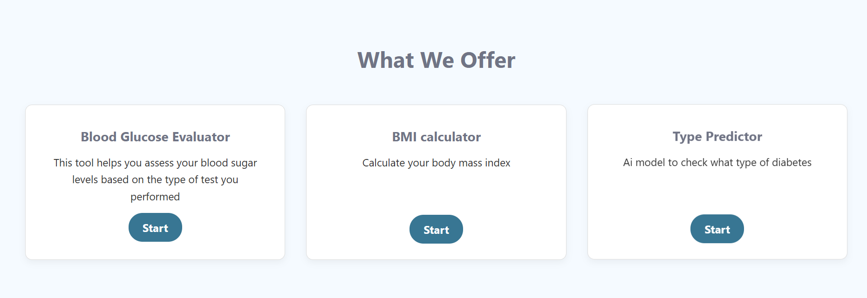
Home Page:

Slide 7
Early Prediction Of
Diabetes
A machine learning model helps in prediction of diabetes at early stage through the symptoms you have.
It depends on symptoms: obesity , delayed healing , polyuria , visual blurring , Polydipsia , Sudden Weight Loss, Weakness , Muscle Stiffness , Partial Paresis ,Delayed Healing , Irritability , Itching , Genital Thrush, polyphagia
1

Slide 8
Early Prediction Of
Diabetes
Gives the user one of two outputs :
1- That he may be a diabetic patient and should go to check
2-The symptoms dont indicate to be a diabetic patient
We used Random Forest Classifier as it was the model with the best accuracy.
accuracy 95%
precision 95%
recall 96%
1

Slide 9
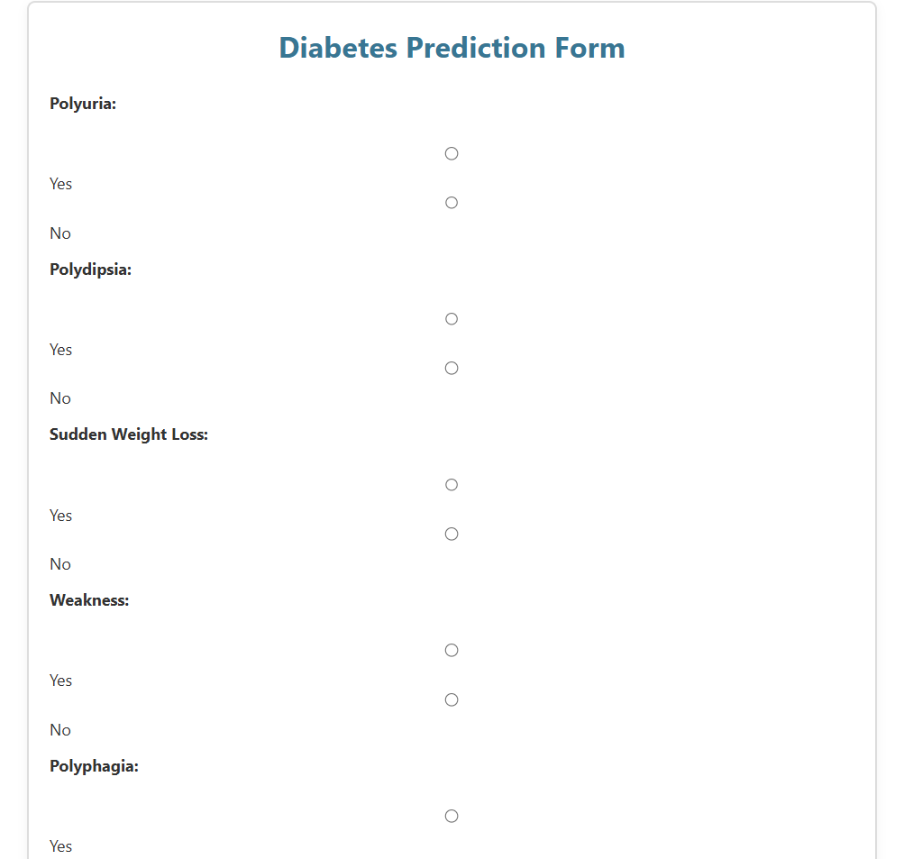
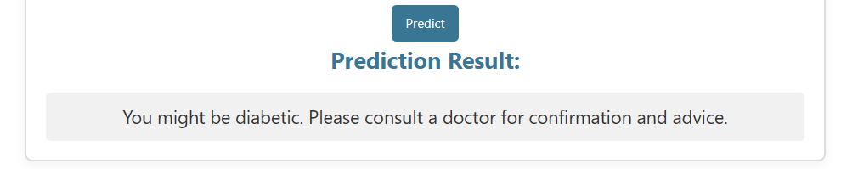
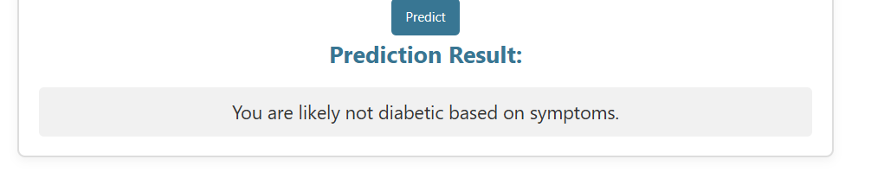
Diabetes prediction page

Slide 10
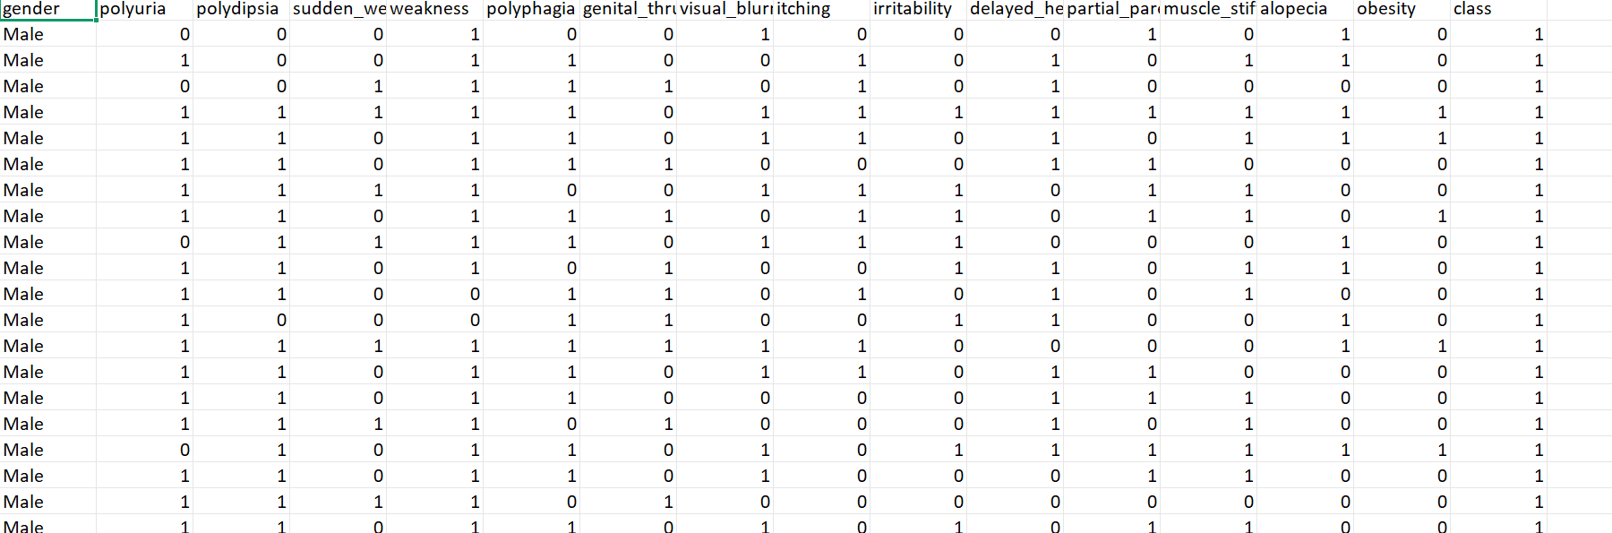

Slide 11
Diabetes Type prediction
Give one of three outputs:
Prediabetic
Type 1
Type 2
It takes inputs like : Age , BMI , insulin levels , blood pressure , blood glucose level , digestive enzyme level
Random Forest Classifier gives accuracy 91%
2

Slide 12
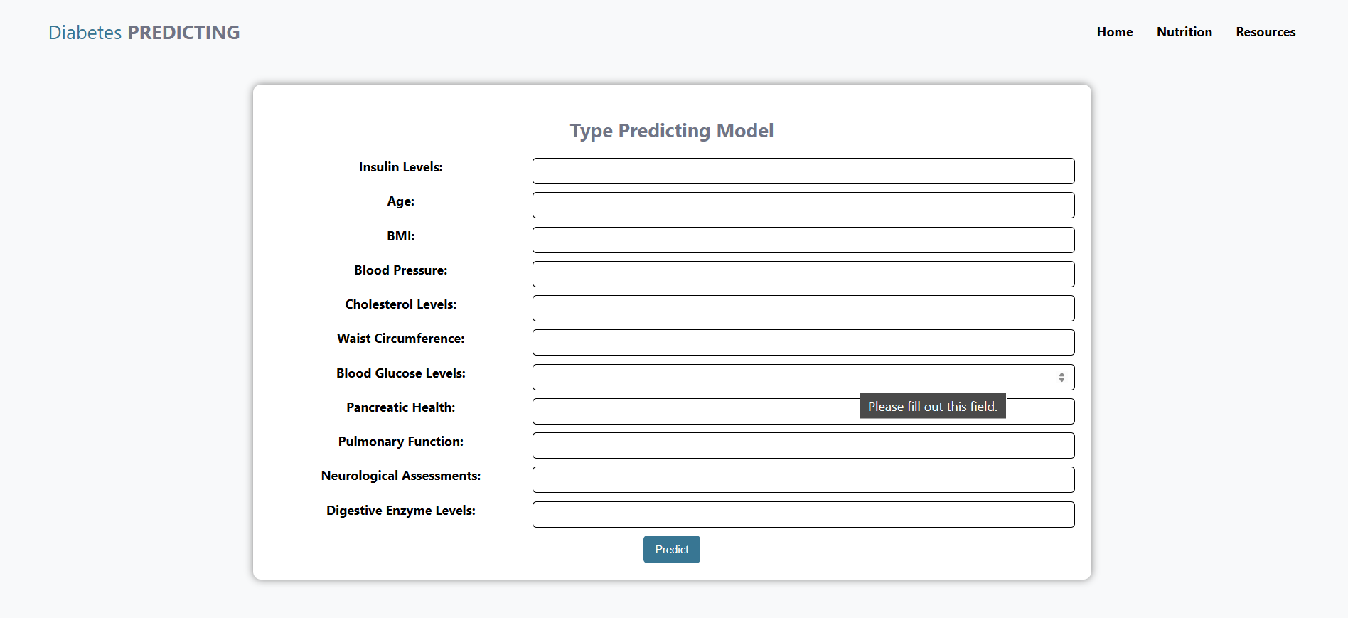

Slide 13
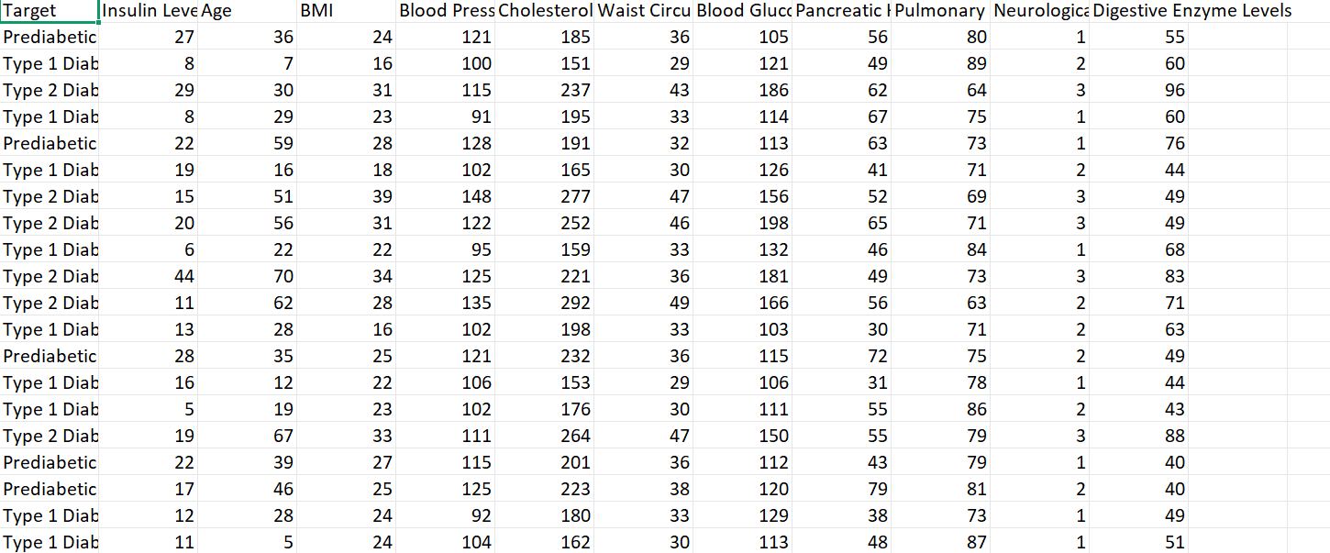

Slide 14
Blood sugar measurement checker
User choose test type:
1- fasting
2-2 Hours after eating
3- HbA1c
choose test unit: mg/dl - mmol/l
The user enter his blood sugar measurement and get output tells him if it Normal - Low -pre diabetic - High
3

Slide 15
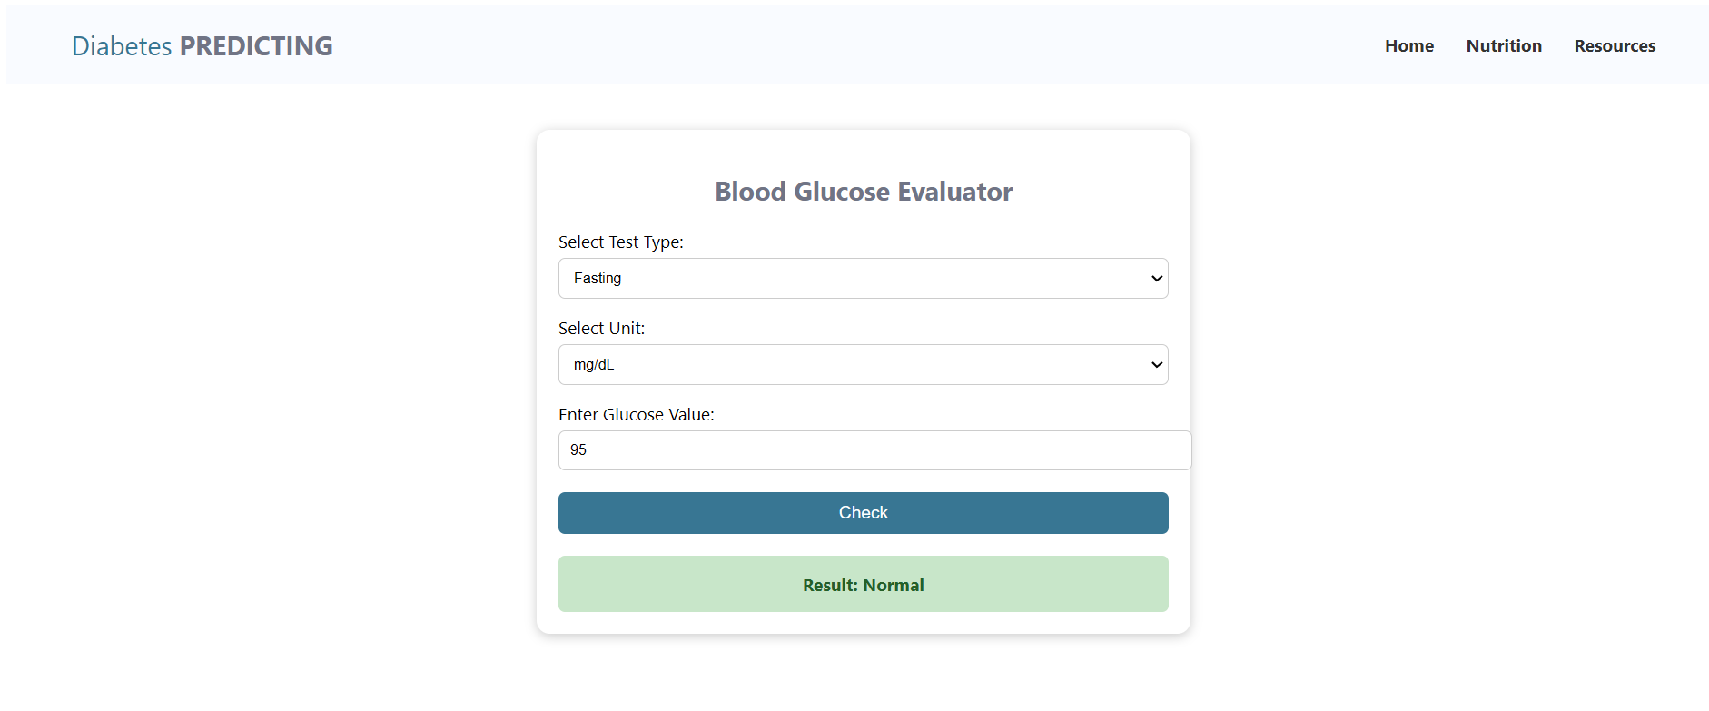
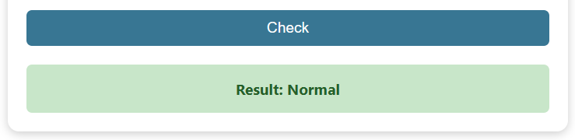
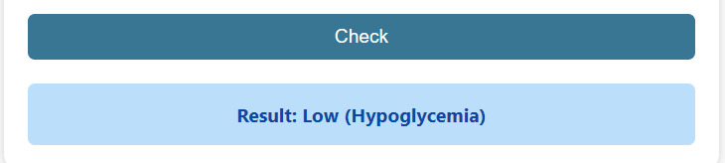
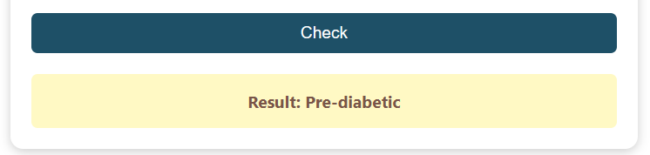
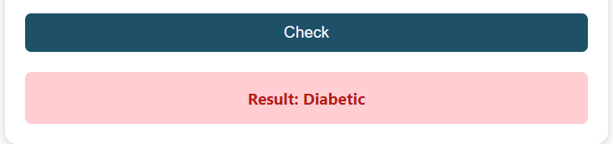

Slide 16
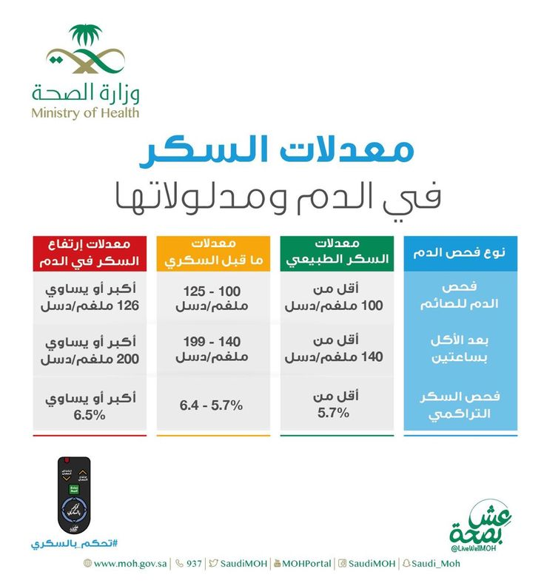

Slide 17
Body Mass Index calculator
Knowing your body mass index, or BMI, can be useful for assessing and adjusting your weight. It is not the most accurate measure of how much body fat you have, but it is the easiest and least expensive way to measure it
BMI = weight / height2
4

Slide 18
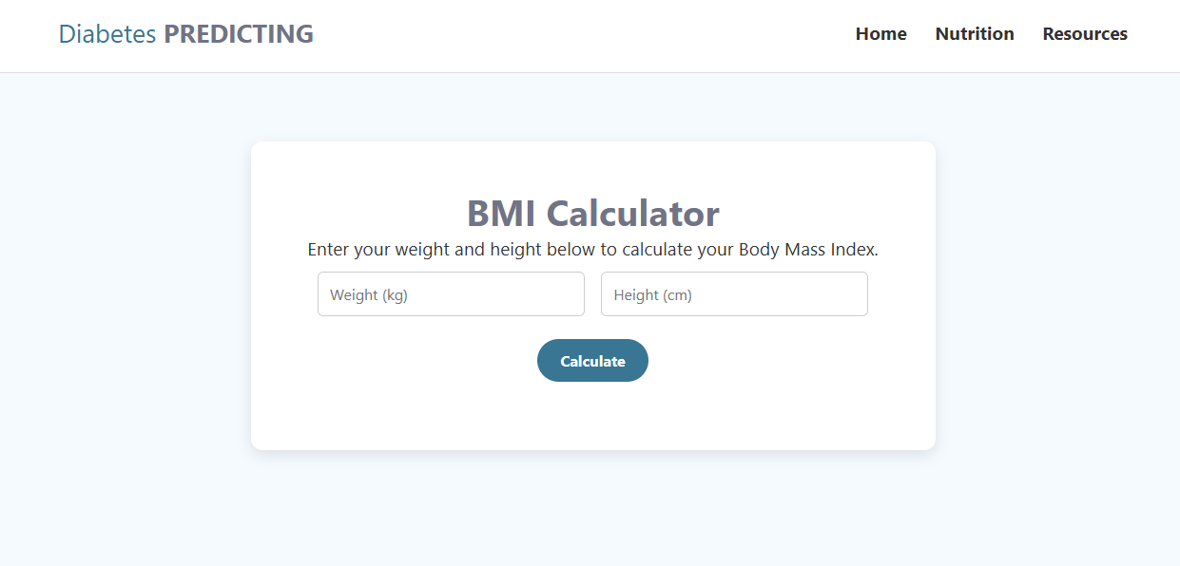
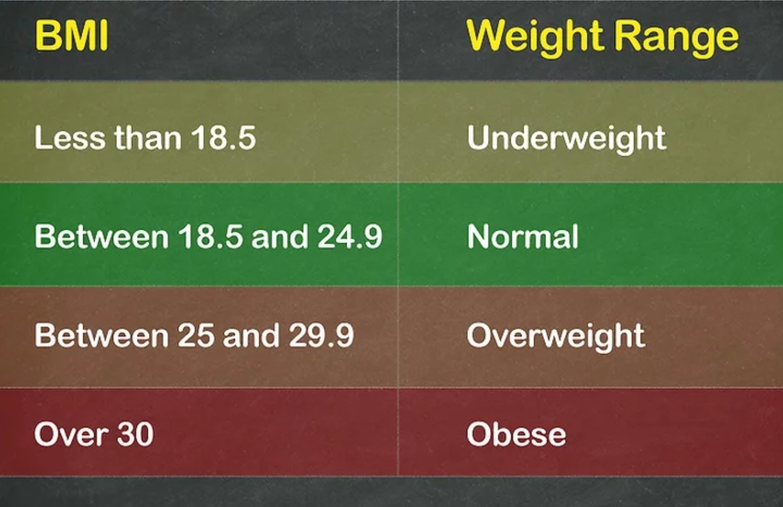

Slide 19
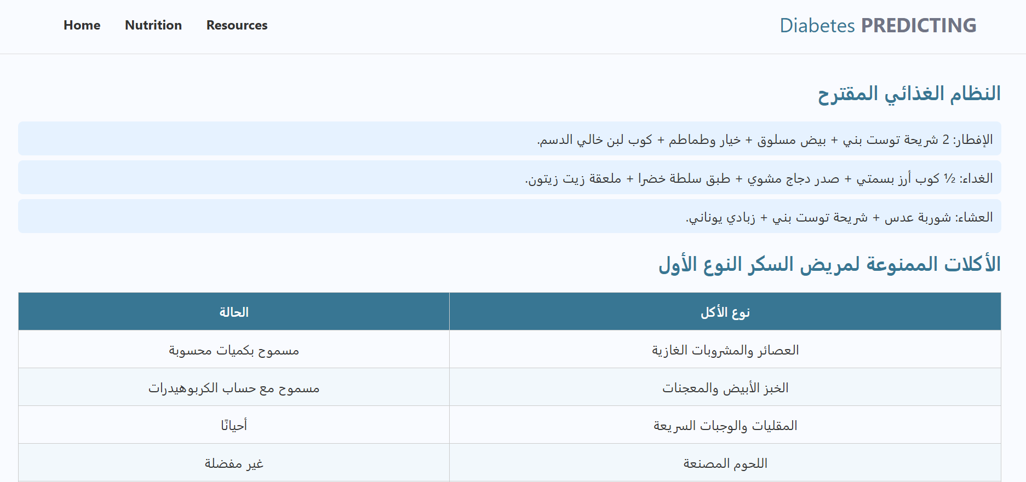
Nutrition tips
These two pages show nutrition plans and restricted foods for people with type 1 and type 2 diabetes.
5

Slide 20

Technologies
Frontend: html , css ,
javascript
Backend: django framework
Machine Learning:
pandas , scikit-learn

Slide 21
Future Work
1.Implement user authentication and profiles to track personal health data over time.
2.Allow users to compare past predictions and monitor trends.
3.Make mobile application version

Slide 22
References:
https://www.kaggle.com/code/ahmedaboraida/early-classification-of-diabetes/input
https://www.dailymail.co.uk/health/article-12136373/Countries-worst-diabetes-rates-world-REVEALED-Americas-position-shock-you.html
https://www.moh.gov.sa/awarenessplateform/ChronicDisease/Pages/Diabetes.aspx
https://www.nature.com/articles/s41597-023-02737-4
https://data.mendeley.com/datasets/wj9rwkp9c2/1
https://www.tandfonline.com/doi/full/10.1080/08839514.2022.2145644#infos-holder
https://onlinelibrary.wiley.com/doi/10.1155/2022/7899364

Slide 23
THANKS

